Slide 1


Zero-Downtime Live Migration of Stateful VMs on Kubernetes
Felicitas Pojtinger
@pojntfx

Slide 2


Felicitas
Pojtinger
bluesky: @felicitas.pojtinger.com
mastodon: @pojntfx@mastodon.social
github/twitter: @pojntfx
linkedin: in/pojntfx
web: felicitas.pojtinger.com

Slide 3
VMs in the Container Age

Slide 4
High overhead
Resource-intensive
Slow to start

Slide 5





Slide 6
So why is everything still powered by VMs?
(Or: Why doesn’t everyone just use containers?)

Slide 7
A "Container of Stateful Applications"?

Slide 8
Good networking support
Small image sizes
Low overhead
Fast to start
Easy to scale
Easy to build & distribute

Slide 9
What Could We Do With Such a New Compute Unit?

Slide 10
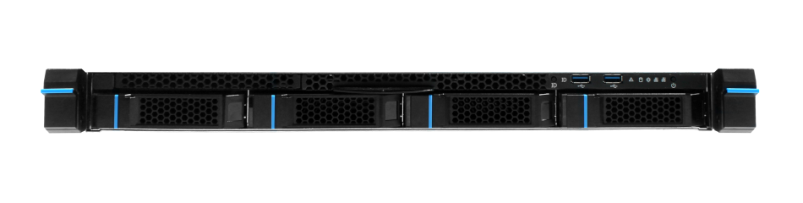

Simplifying deployment
and debugging
Image source: https://archive.ph/pBMM7, last accessed 2023-10-31
Notes:
Yes we’ve solved this with networking too

Slide 11



Moving between cloud providers without downtime
Notes:
From the client side: A user is able to move between clouds based on price
From the cloud provider side: Fixes the binpacking problem

Slide 12
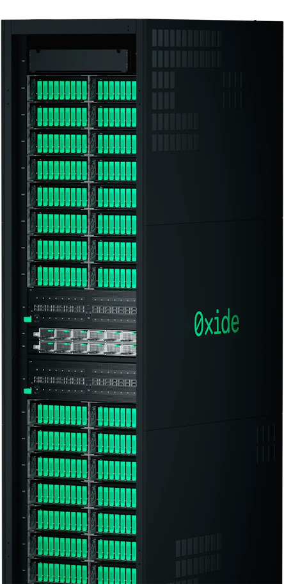

Moving long-running processes to more powerful servers (while continuing computing)
Image source: https://archive.ph/pL8ih, last accessed 2023-10-31

Slide 13
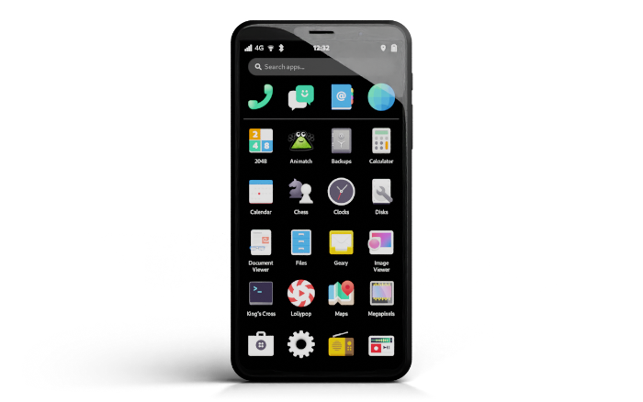


Migrating full desktop/mobile apps between devices (in milliseconds)
Image source: https://archive.ph/BWU0Q, last accessed 2023-10-31
Notes:
Scene in Avatar where you “take with the app with on your phone and then just move it to your computer”

Slide 14


Moving stateful services closer to your users as they access them (without downtime)

Slide 15
This sounds great
But it’s also impossible …
right?
Notes:
History of doing things that are supposed to be impossible

Slide 16
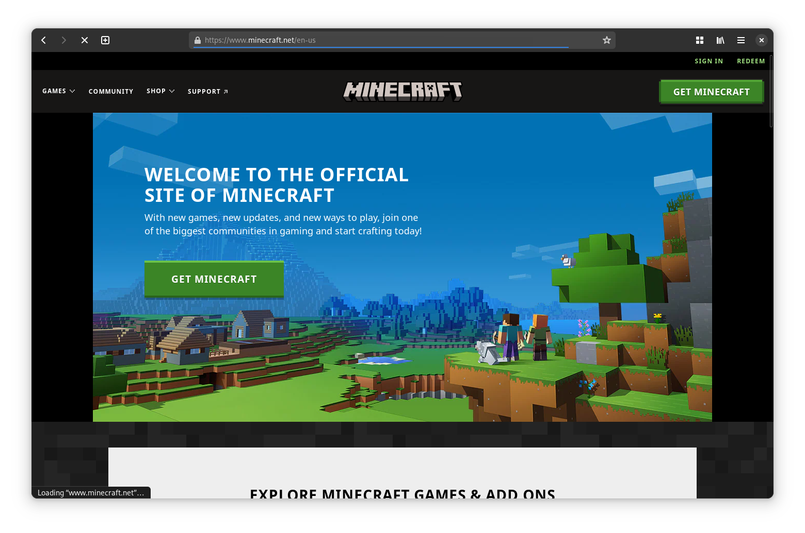
minecraft.net (Version 1.12.2)

Slide 17
Why Does This Not Exist Already?

Slide 18
Dated hypervisor ecosystems
Live migration is complex
VMs can’t be streamed in
IPs change after migrations
Outdated packaging tooling
Not designed for modern orchestrators

Slide 19
How Did We Implement It Anyway?

Slide 20
A (Very Brief) Overview of Existing Live Migration Techniques

Slide 21
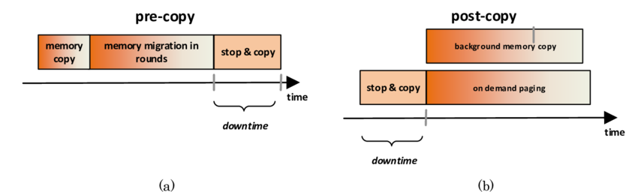
Pre-Copy Migration
Image source: https://archive.ph/pBMM7, last accessed 2023-10-31
Notes:
Armotizes the cost over time

Slide 22
Post-Copy Migration
Image source: https://archive.ph/pBMM7, last accessed 2023-10-31

Slide 23
Remote Memory

Slide 24
Highly application-specific
Dependent on specific transports
Very latency-sensitive
Not easily extensible

Slide 25
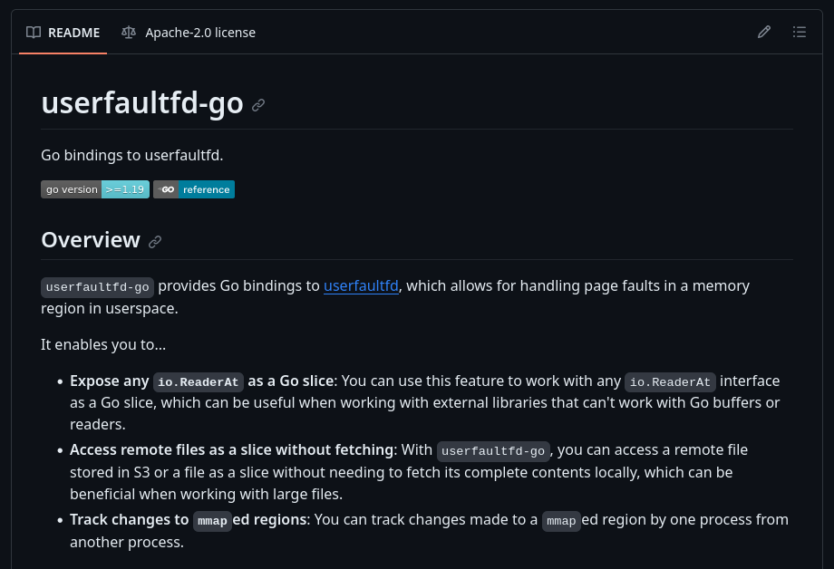
What about userfaultfd?

Slide 26
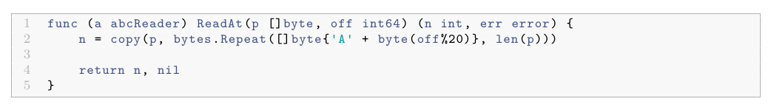
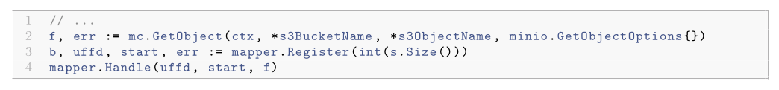
What about userfaultfd?

Slide 27
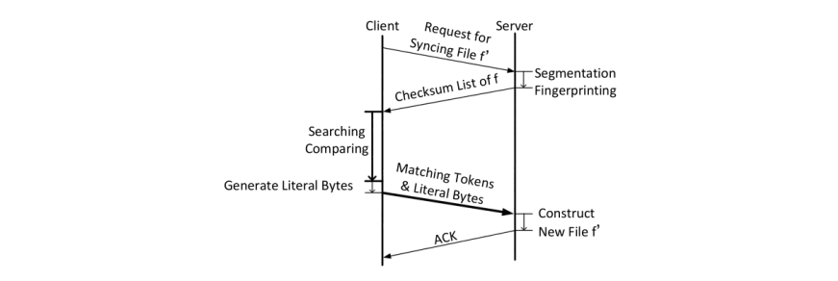
File-based synchronization

Slide 28
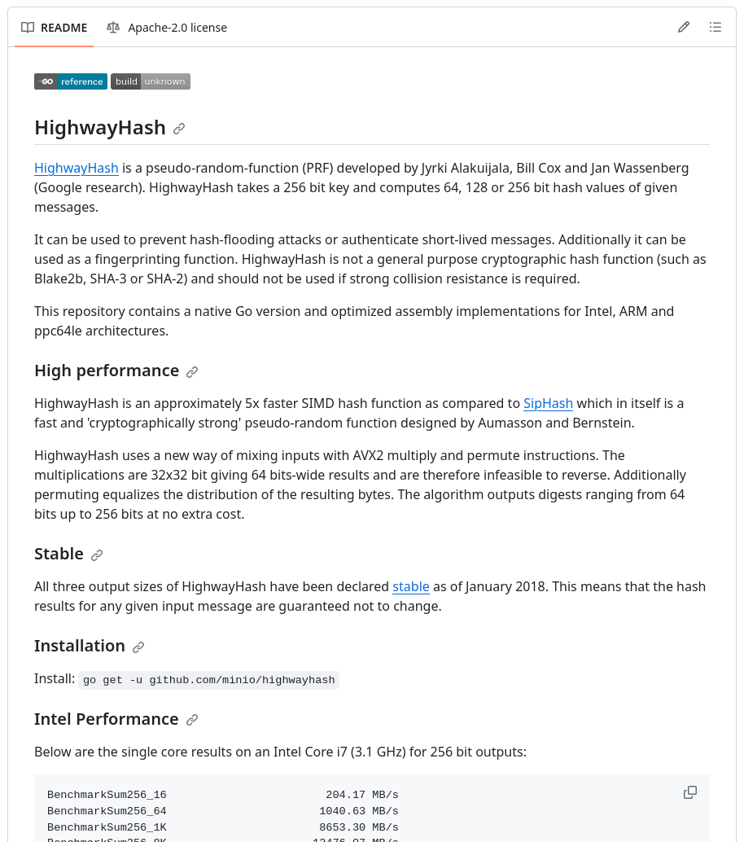
File-based synchronization

Slide 29
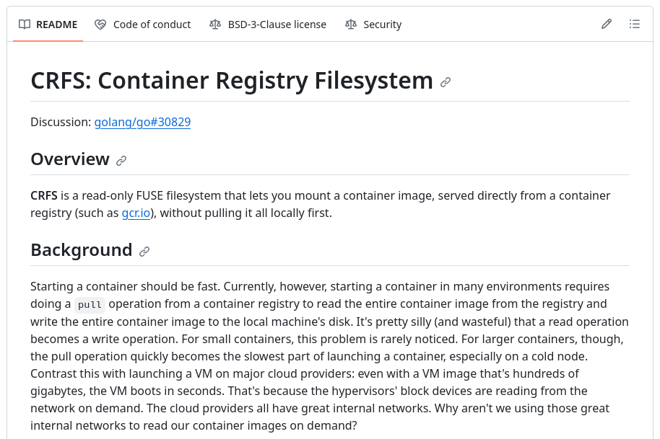
CRFS

Slide 30
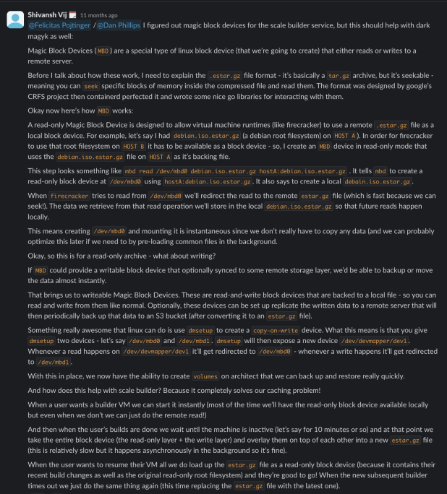
MBDs

Slide 31
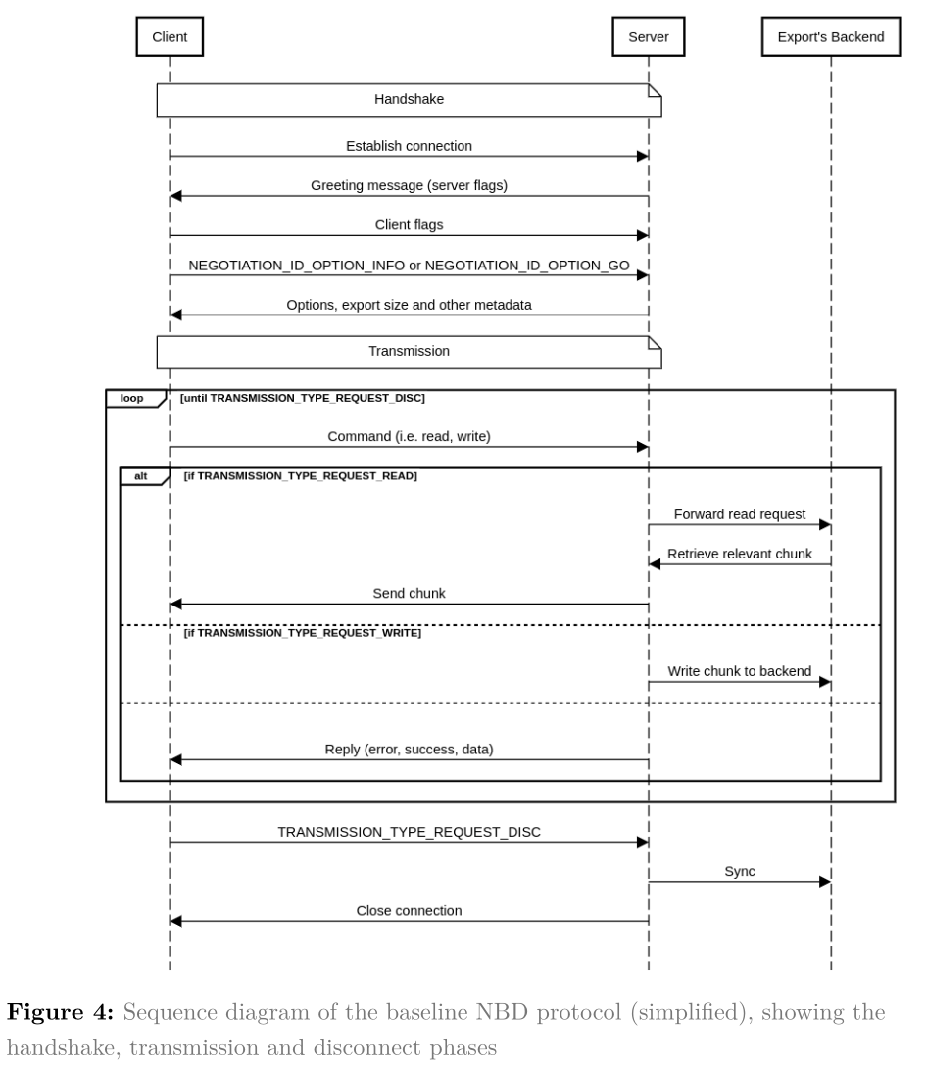
NBD

Slide 32
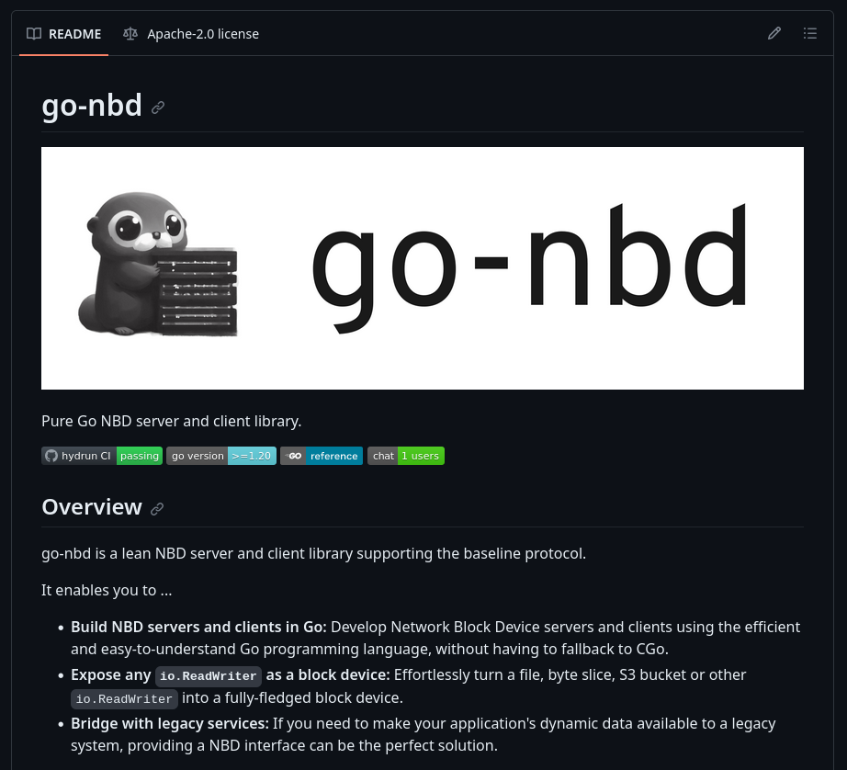
NBD with go-nbd

Slide 33
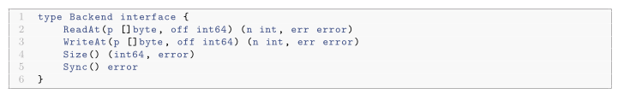
NBD with go-nbd

Slide 34
What about RTT?

Slide 35
r3map
A Universal Resource Mount and Migration Solution (“remote mmap”)

Slide 36
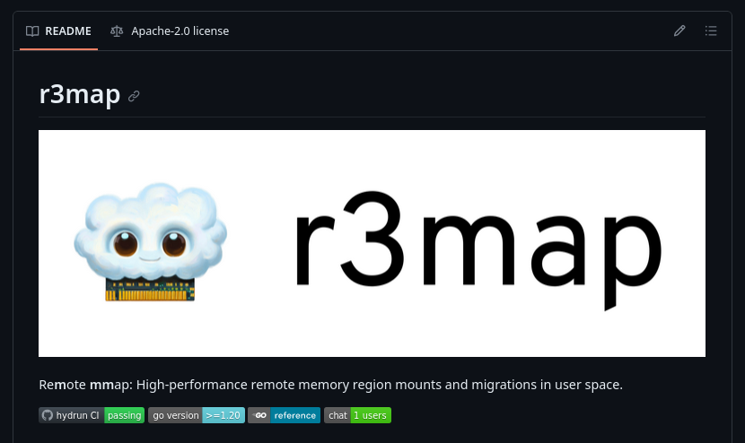

r3map

Slide 37
Concurrency
Lifecycle management/hooks
Pre-emptive pulls
Workload analysis
Pull priority heuristics
Network protocol
Caching
Mounts & migrations
Language-independent

Slide 38
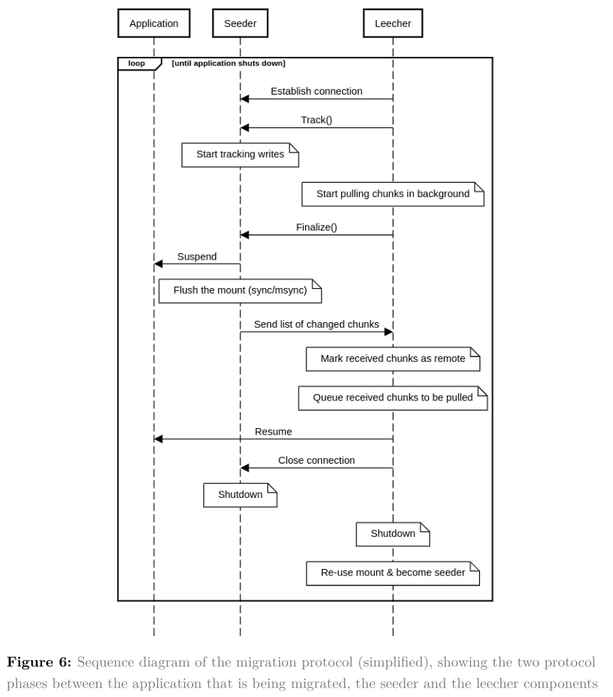
Migration

Slide 39
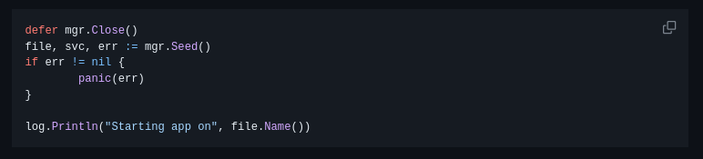
Seeder

Slide 40
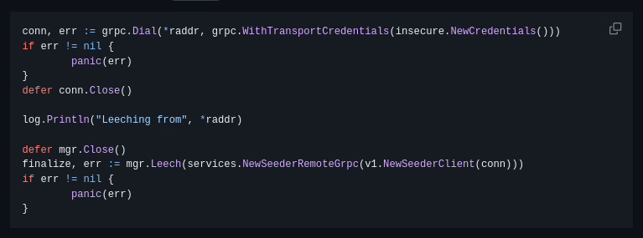
Leecher

Slide 41
How Fast Is r3map?

Slide 42
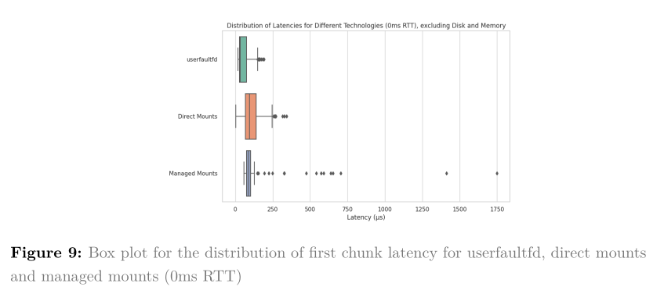
Latency (0 ms RTT)

Slide 43
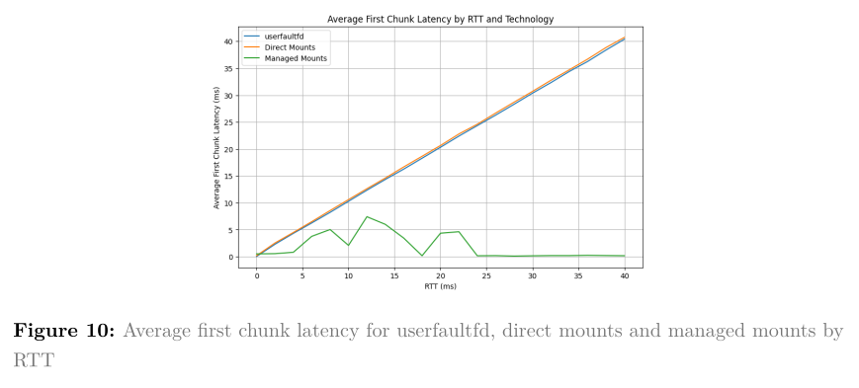
Latency (by RTT)

Slide 44
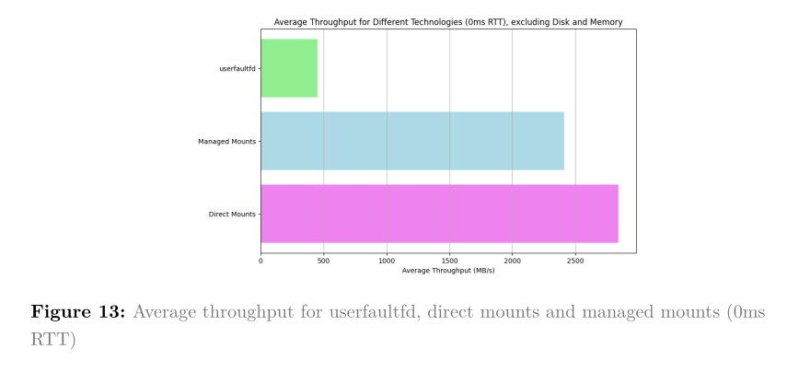
Read Throughput (0 ms RTT)

Slide 45
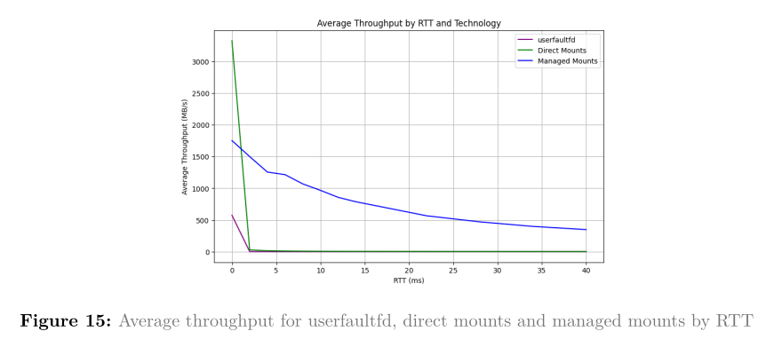
Read Throughput (by RTT)

Slide 46
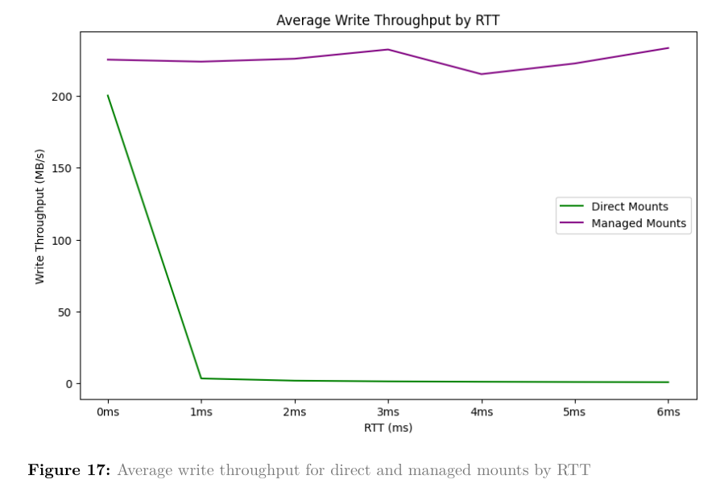
Write Throughput (by RTT)

Slide 47
Using r3map with Firecracker

Slide 48
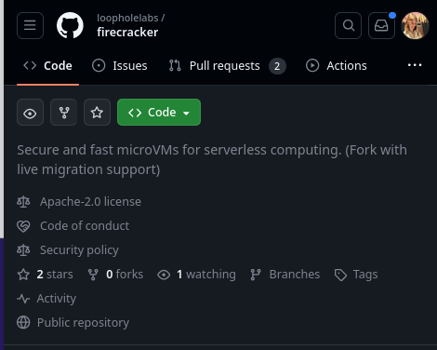

Slide 49
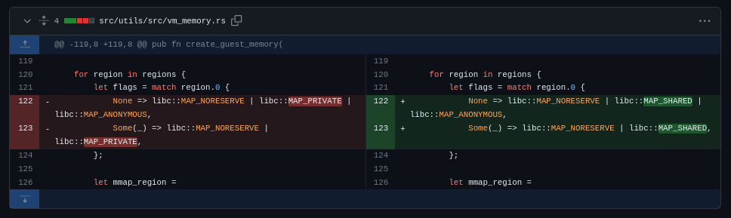

Slide 50
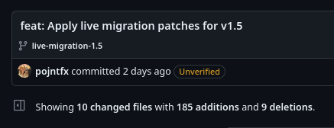

Slide 51
Architekt
Tooling and orchestration for live migration with r3map and Firecracker

Slide 52
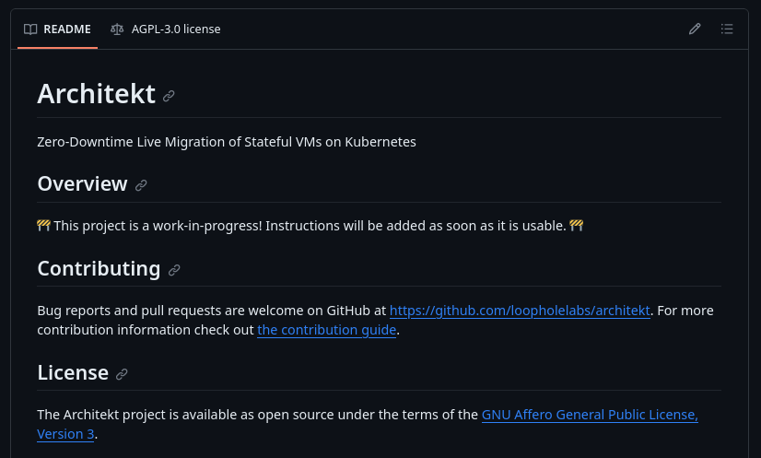
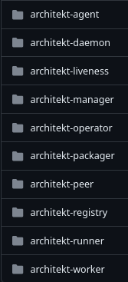

Slide 53
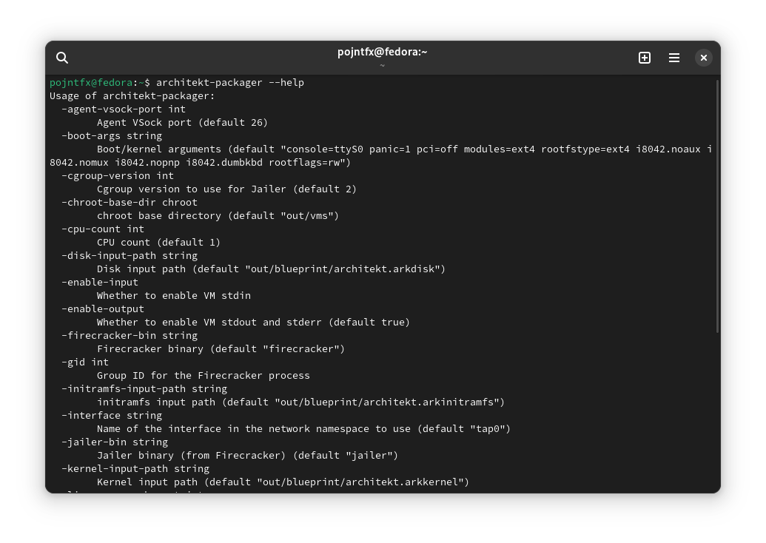
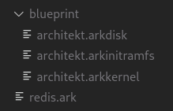
Architekt Packager

Slide 54
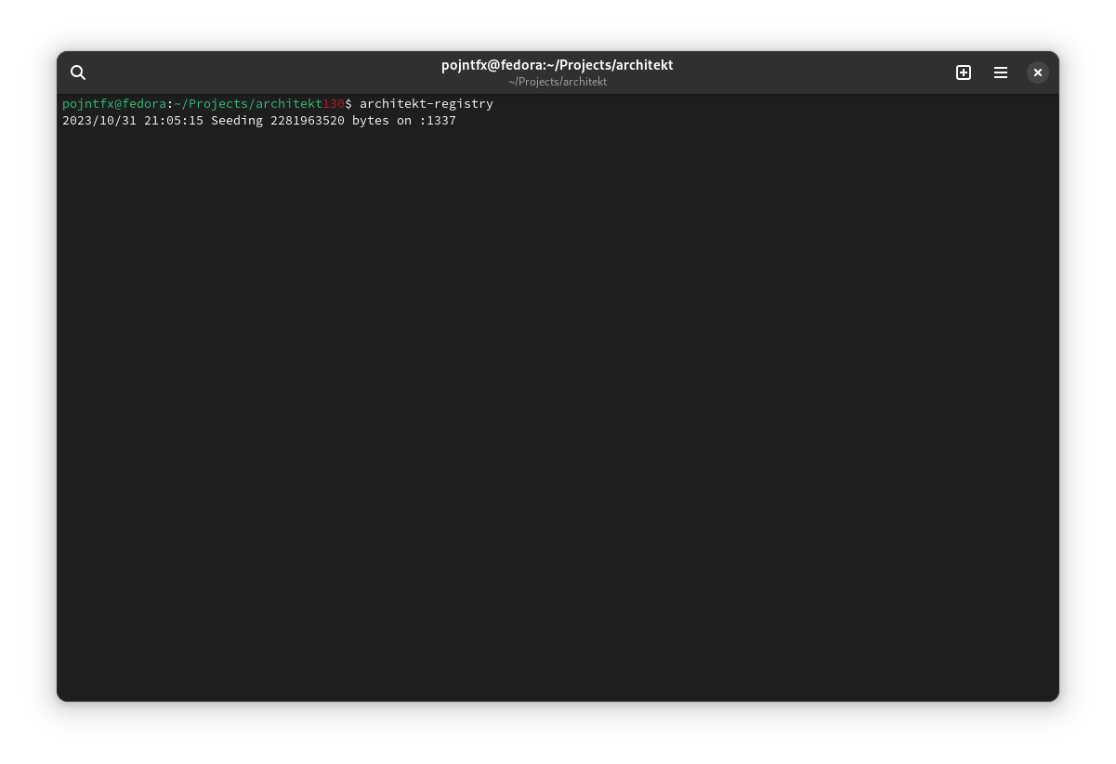
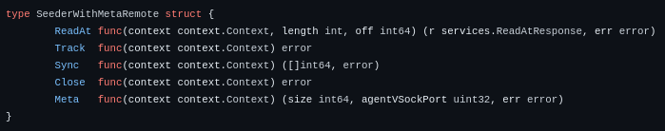
Architekt Registry

Slide 55
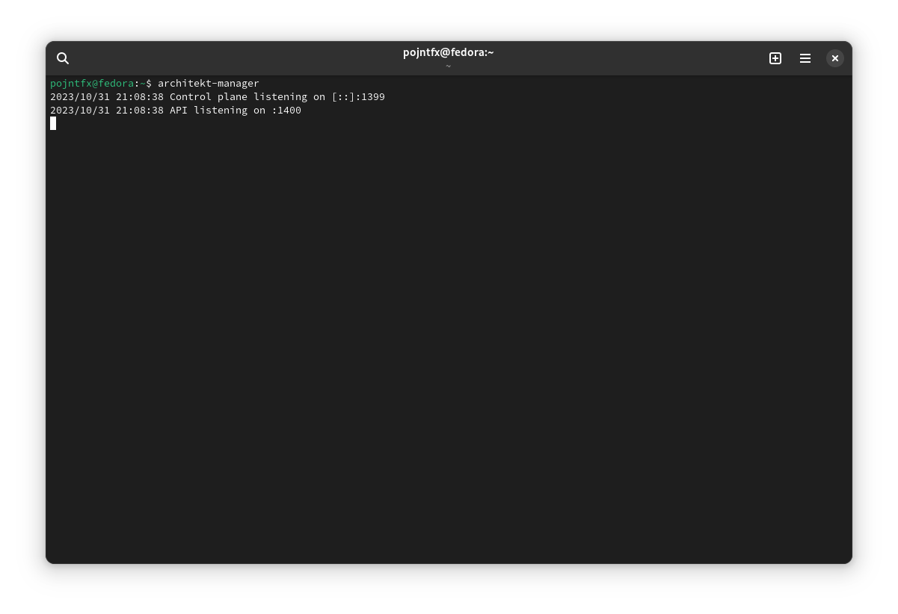
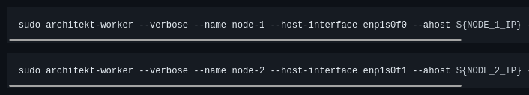
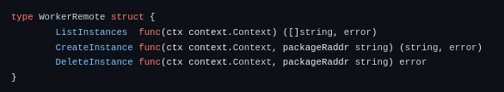
Architekt Control Plane

Slide 56
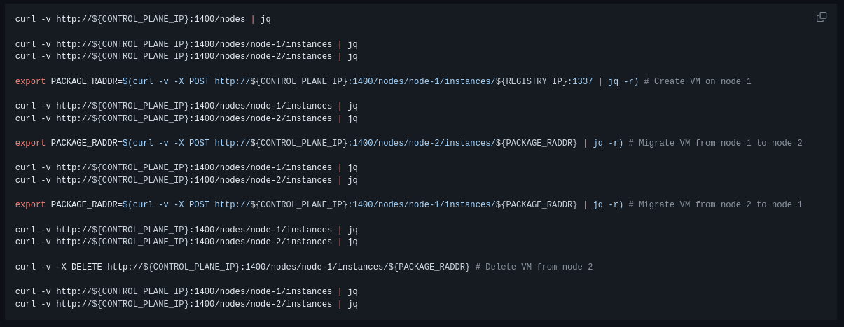
Architekt Control Plane API

Slide 57
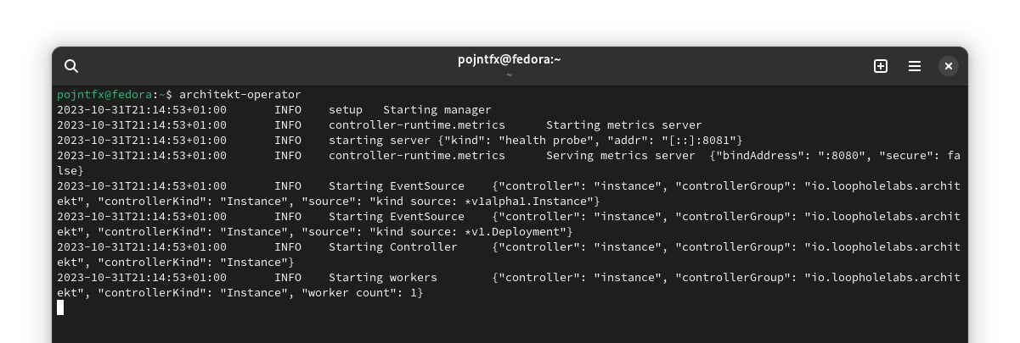
Architekt Kubernetes Operator
Notes:
That’s why there is a k in Architekt

Slide 58
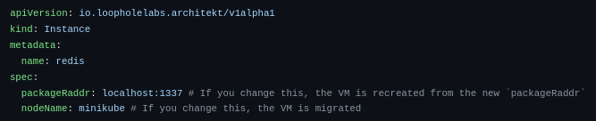
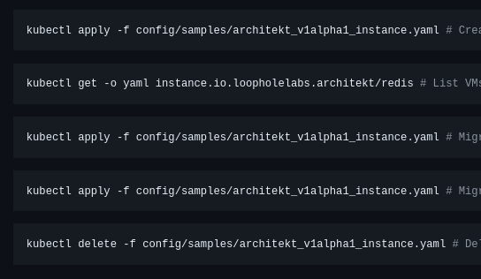
Architekt Instance CRD

Slide 59
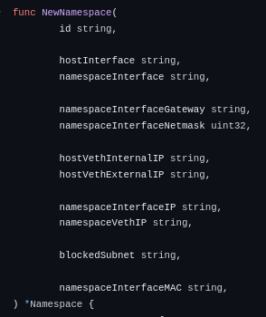
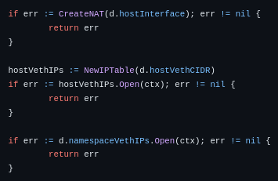
VM Network Interfaces

Slide 60
IP 1
IP 2

Slide 61
Lynk
A new approach to networking

Slide 62
Independent of network topology
Can be deployed behind firewalls
Nodes do not require a public IP
Automatically handles TLS encryption in flight
Can keep connections alive during migration
Tightly integrated with Architekt
Notes:
It’s not just a proxy cause if you move, the latency doesn’t get worse, it gets better

Slide 63
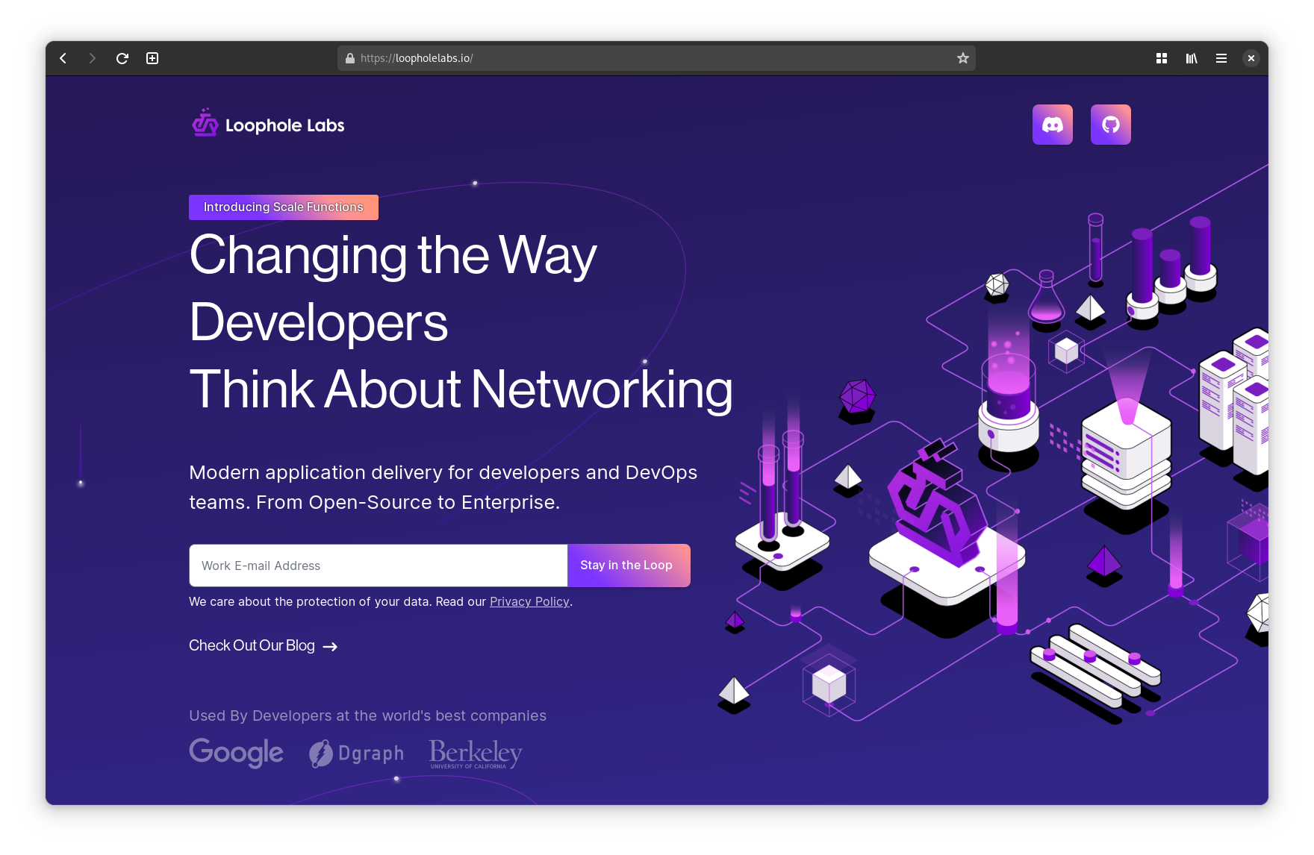
loopholelabs.io

Slide 64
But Does This Actually Work?

Slide 65




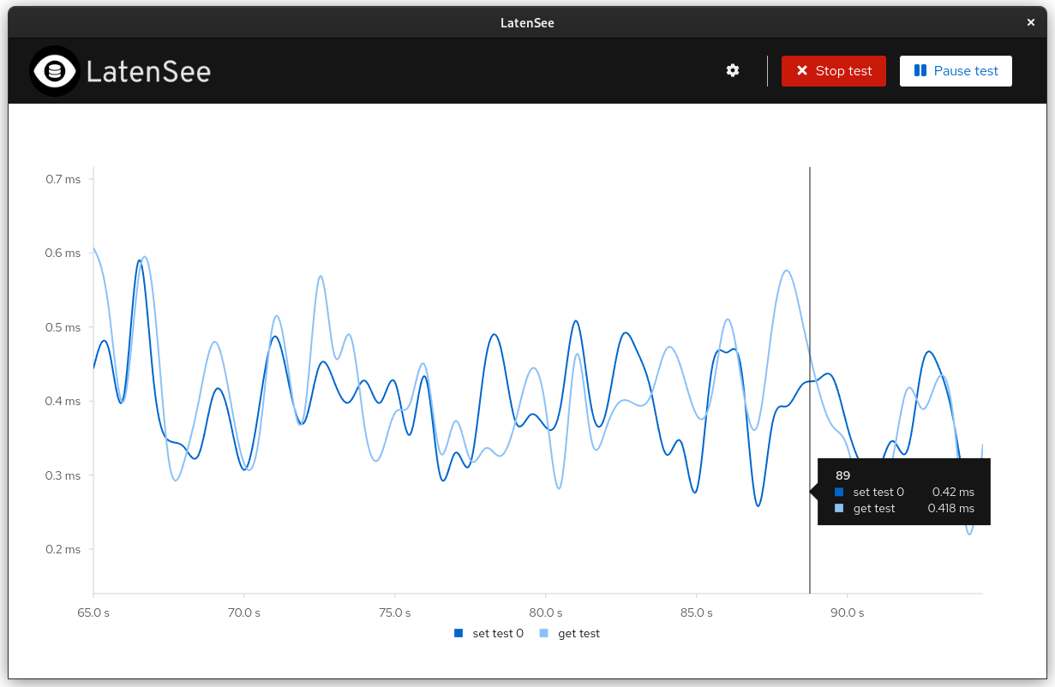



Slide 66
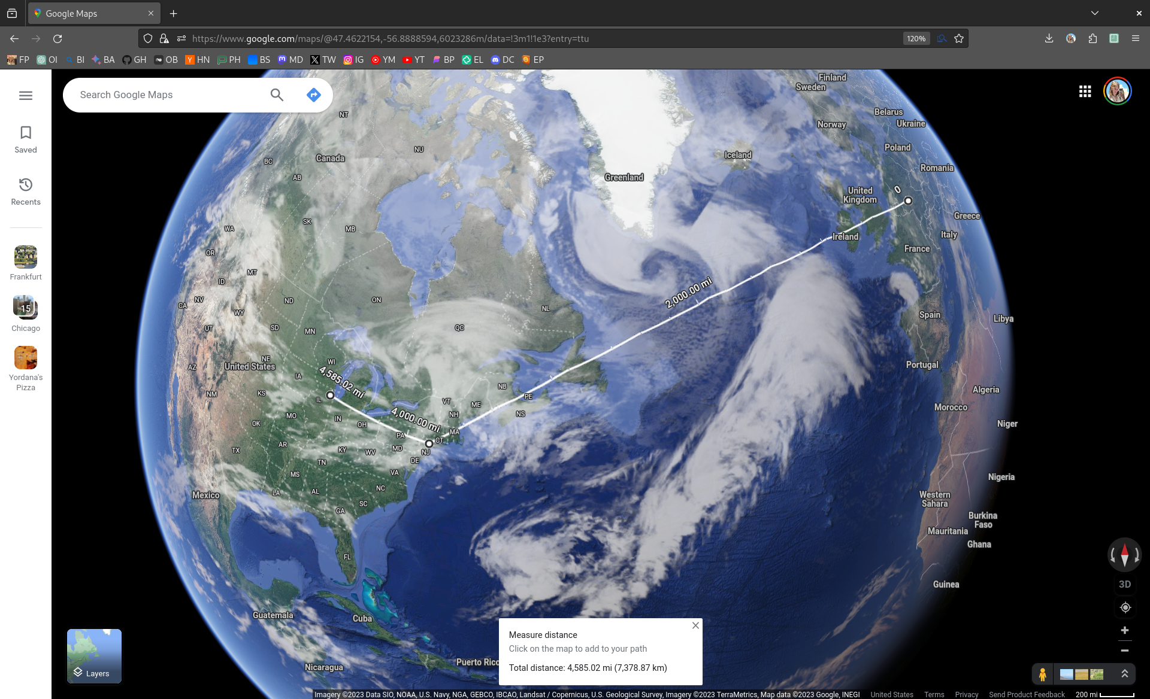
Notes:
And you will see that the only real limit here is light speed

Slide 67
Live Demo

Slide 68

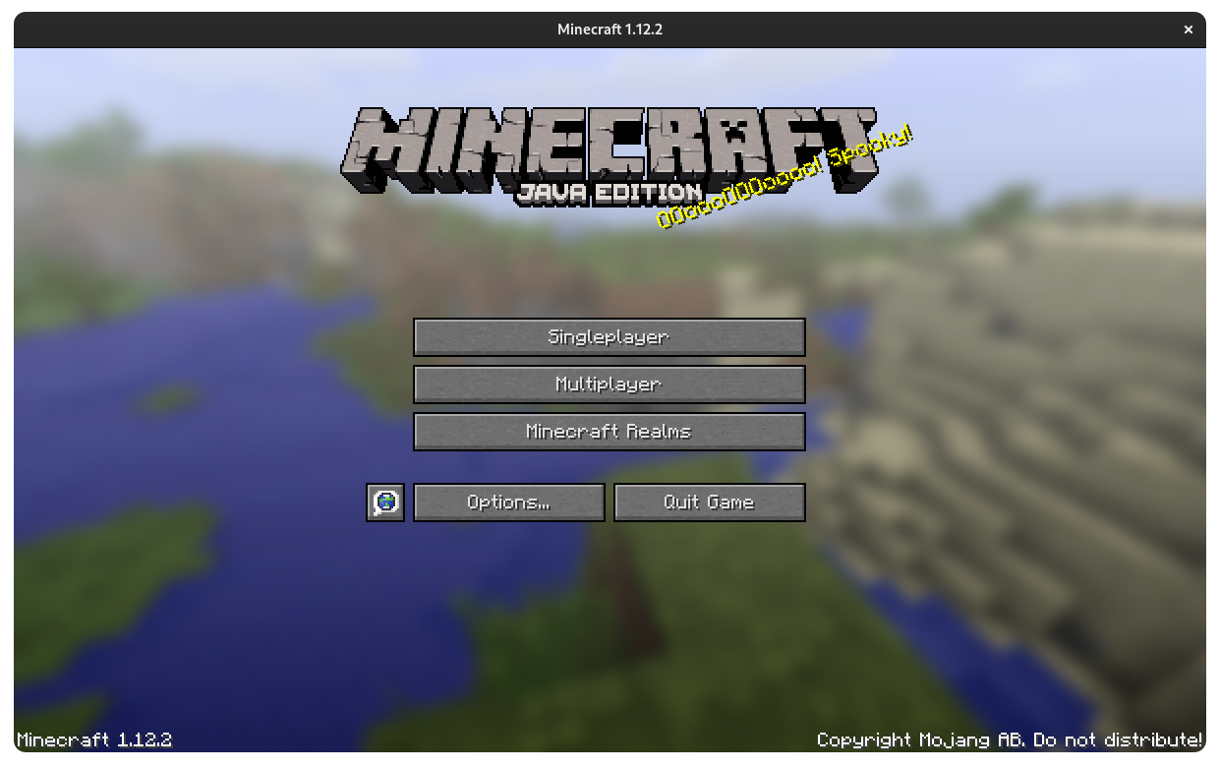

Slide 69
Live Demo
Connect to:
minecraft.architect.run
Minecraft 1.12.2
Notes:
Say the domain out loud

Slide 70
Recap: We Can We Do With This New Compute Unit?

Slide 71
Simplifying deployment
and debugging
Image source: https://archive.ph/pBMM7, last accessed 2023-10-31

Slide 72
Moving between cloud providers without downtime

Slide 73
Moving long-running processes to more powerful servers (while continuing computing)
Image source: https://archive.ph/pL8ih, last accessed 2023-10-31

Slide 74
Migrating full desktop/mobile apps between devices (in milliseconds)
Image source: https://archive.ph/BWU0Q, last accessed 2023-10-31

Slide 75
Moving stateful services closer to your users as they access them (without downtime)

Slide 76
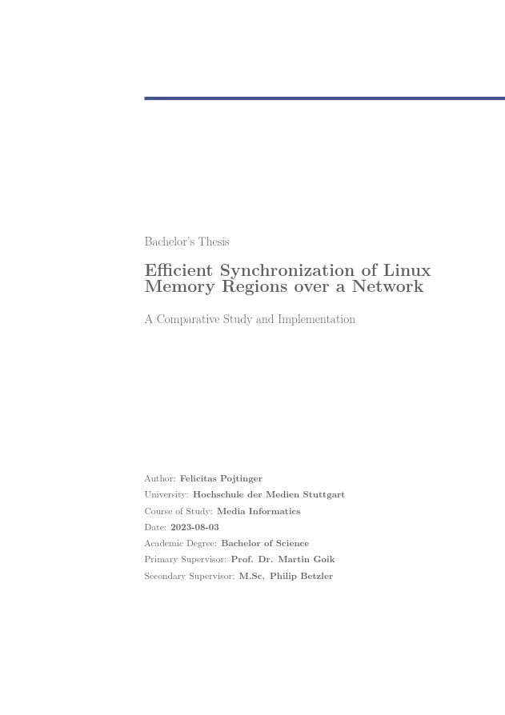
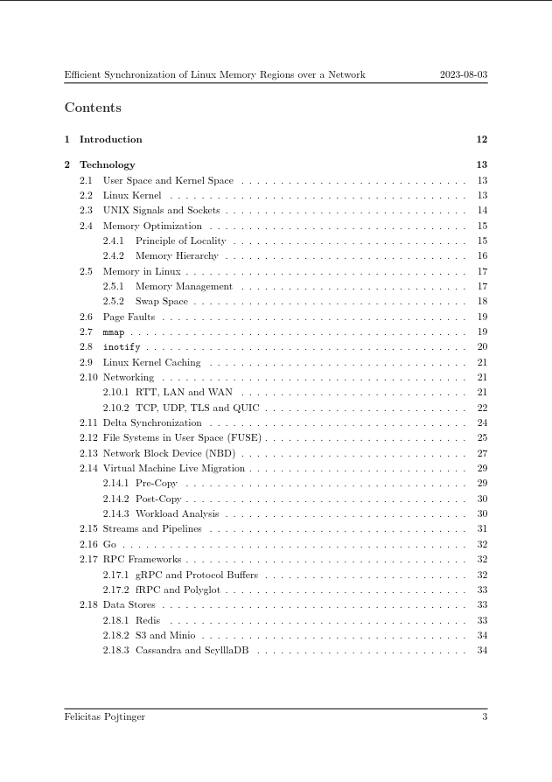
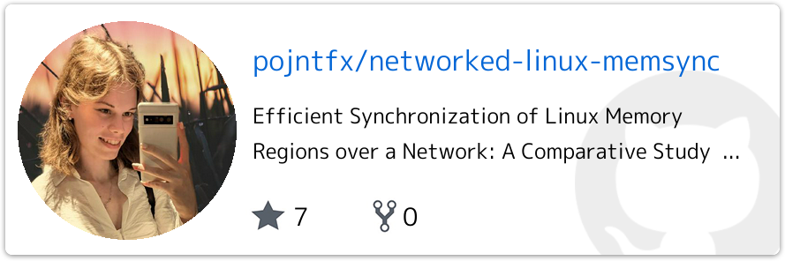

Slide 77
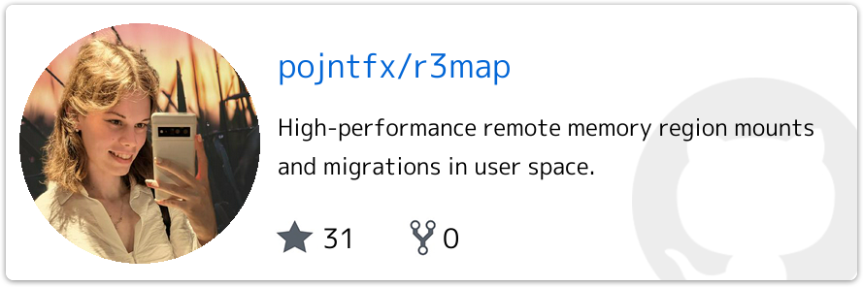




Slide 78

Come talk to us!

Slide 79
Felicitas
Pojtinger
bluesky: @felicitas.pojtinger.com
mastodon: @pojntfx@mastodon.social
github/twitter: @pojntfx
linkedin: in/pojntfx
web: felicitas.pojtinger.com

Slide 80

github/twitter: @LoopholeLabs
discord: loopholelabs.io/discord
web: loopholelabs.io

